Slide 1


Sarsha J S
June 10, 2023

Slide 2

Outline
Executive Summary
Introduction
Methodology
Results
Conclusion
Appendix

Slide 3
Executive Summary
Summary of methodologies
Data collection
Data wrangling
EDA with SQL
EDA with visualization
Interactive visual analytics with folium
Interactive dashboard with Plotly Dash
Machine Learning prediction
Summary of all results
EDA results
Interactive results
Prediction results

Slide 4
Introduction
Project background and context
The commercial space age is here, companies are making space travel affordable for everyone.
Virgin Galactic is providing suborbital spaceflights. Rocket Lab is a small satellite provider. Blue
Origin manufactures sub-orbital and orbital reusable rockets. Perhaps the most successful is
SpaceX. SpaceX’s accomplishments include: Sending spacecraft to the International Space
Station. SpaceX advertises Falcon 9 rocket launches on its website with a cost of 62 million
dollars; other providers cost upwards of 165 million dollars each, much of the savings is
because SpaceX can reuse the first stage.
Problems you want to find answers
Predict whether Falcon 9 first stage will land successfully or not.

Slide 5

Section 1

Slide 6
Methodology
Executive Summary
Data collection methodology:
Data is collected using SpaceX rest API.
Web Scrapping from Wikipedia is done by BeautifulSoup.
Perform data wrangling
Data cleaning to handle missing values, remove null values and removing unnecessary columns.
Perform exploratory data analysis (EDA) using visualization and SQL
Perform interactive visual analytics using Folium and Plotly Dash
Perform predictive analysis using classification models
Logical regression, Support Vector Machines, Decision Tree, KNN algorithms have been used to train and test the models.

Slide 7
Data Collection
Describe how data sets were collected.
Data sets were collected using SpaceX REST API.
This API will give data about launches, including information about the rocket used, payload delivered, launch specifications, landing specifications and landing outcomes.
Use the URL to target a specific endpoint of the API to get past launch data.
Perform a get requests using requests library to get the data from API. Response will be in JSON form.
Use json_normalize function to convert the JSON to dataframe.
Parse the data and convert it into pandas dataframe.
You need to present your data collection process use key phrases and flowcharts

Slide 8
Collect data from SpaceX REST API
Informations like Launchsites, payload,landing outcomes.
Use URL to target specific endpoint of API
Perform GetRequests
Response is JSON
Use json_normalize to convert to dataframe
Parse the data and convert to pandas dataframe
Data is ready for analysis

Slide 9
Data Collection – SpaceX API
Using URL collect the data from spaceX
Using json_normalize function convert the response JSON file into dataframe.
Using the data obtained combine the columns into a dictionary.
Using replace() and mean function to replace Nan values with the mean values.
Using BoosterVersion filter the data to keep only Falcon 9 data.
Https://github.com/SarshaJS18/myrepo/blob/main/Week_1_Data_Collection_using_API.ipynb

Slide 10
Data Collection - Scraping
Perform an HTTP GET method to request the Falcon9 Launch HTML page, as an HTTP response.
Collect all relevant column names from the HTML table header.
Create an empty dictionary with keys from the extracted column names.
Parse launch records into the dictionary.
Convert the dictionary into dataframe.
Create a BeautifulSoup object from the HTML .
GitHub URL: https://github.com/SarshaJS18/myrepo/blob/main/Week1_webscraping.ipynb

Slide 11
Data Wrangling
Load Space X dataset, from last section.
Use the method value_count() on the column to determine the number of launches on each site.
Use the method value_counts() to
determine the number and occurrence of each orbit in the column
Determine the success rate.
Create a landing outcome label from outcome column.
Use the method .value on the column to determine the number of landing outcomes.
https://github.com/SarshaJS18/myrepo/blob/main/week1_data_wrangling.ipynb

Slide 12
EDA with Data Visualization
The charts used are:
Scatter point chart- for visualizing the relationship between variables, such as the relationship between payload mass and launch sites.
Bar chart- for visualizing the relationship between success rate and orbit type.
Line chart- for visualizing the success rate.
Github URL: https://github.com/SarshaJS18/myrepo/blob/main/Week2_lab2_EDA_with_Visualization.ipynb

Slide 13
EDA with SQL GithubURL:https://github.com/SarshaJS18/myrepo/blob/main/Week_2_lab1_EDA_withSQL.ipynb
SQL queries performed:
Display the names of the unique launch sites in the space mission.
Display 5 records where launch sites begin with the string 'CCA‘.
Display the total payload mass carried by boosters launched by NASA (CRS).
Display average payload mass carried by booster version F9 v1.1.
List the names of the boosters which have success in drone ship and have payload mass greater than 4000 but less than 6000.
List the total number of successful and failure mission outcomes.
List the names of the booster_versions which have carried the maximum payload mass. Use a subquery.
List the records which will display the month names, failure landing_outcomes in drone ship ,booster versions, launch_site for the months in year 2015.
Rank the count of successful landing_outcomes between the date 04-06-2010 and 20-03-2017 in descending order.

Slide 14
Build an Interactive Map with Folium
The map objects created and added to a folium map are:
Circle – to add a highlighted circle area with a text label on a specific coordinate.
Marker – to show a specific location.
Line – to show multiple connected points to represent boundaries, routes etc.
Marker_cluster – to show a map containing many markers having the same coordinate.
GitHub URL: https://github.com/SarshaJS18/myrepo/blob/main/Week3_lab1_Interactive_visual_analytic_with_folium.ipynb

Slide 15
Build a Dashboard with Plotly Dash
Plots/graphs and interactions added to a dashboard are:
Scatter plot – visualizing the relationship between two continuous variables.
Line chart - visualizing changes in data over continuous or discrete intervals.
Pie chart - visualizing percentages or proportions.
GitHub URL: https://github.com/SarshaJS18/myrepo/blob/main/spacex_dash_app.py

Slide 16
Predictive Analysis (Classification)
Create a NumPy array from the column Class in data using to_numpy() method and assign it to variable Y
Standardize the data in X then reassign it to the variable X using the transform
Use the function train_test_split to split the data X and Y into training and test data
Find best Hyperparameter for Logistic Regression, SVM, Decision Tree and KNN
Calculate the accuracy on the test data using the method score
Plot the confusion matrix.
Find the best method based on accuracy.
Github URL: https://github.com/SarshaJS18/myrepo/blob/main/Week4_lab1_Machine_learning_predictive.ipynb

Slide 17
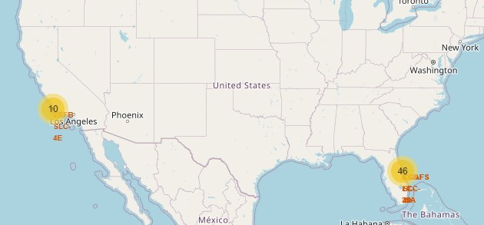
Results
Exploratory data analysis results
Data can be collected using REST API and web scrapping from Wikipedia.
Interactive analytics demo in screenshots
Predictive analysis results
Decision Tree method performs best using test data.

Slide 18

Section 2

Slide 19
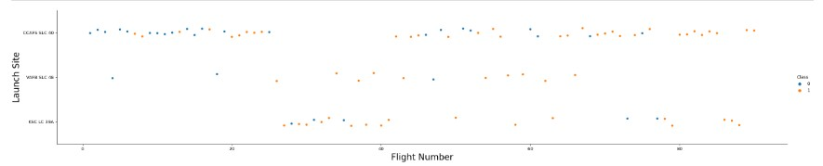
Flight Number vs. Launch Site
Show a scatter plot of Flight Number vs. Launch Site
- The below screenshot shows the relationship between flight Number and launch site.

Slide 20
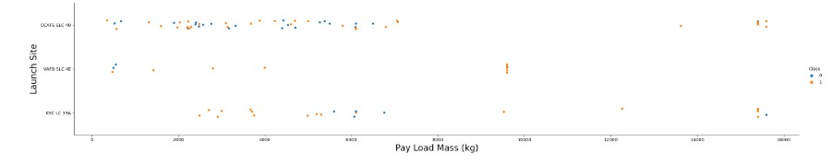
Payload vs. Launch Site
Show a scatter plot of Payload vs. Launch Site
- The screenshot below shows the relationship between Payload and Launch sites.

Slide 21
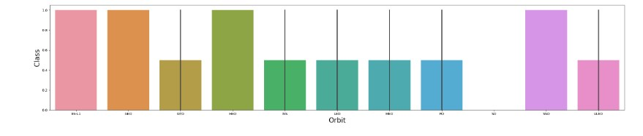
Success Rate vs. Orbit Type
Show a bar chart for the success rate of each orbit type
- The below screenshot shows the orbit SSO, HEO, GEO, ES_L1 have high success and the orbit GTO has low success among all of the orbits.

Slide 22
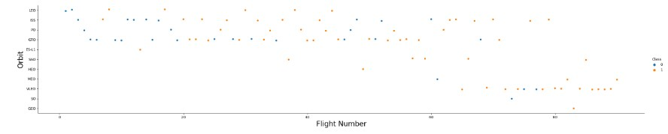
Flight Number vs. Orbit Type
Show a scatter point of Flight number vs. Orbit type
- The below screenshot shows the success occur in LEO orbit and not in GTO orbit.

Slide 23
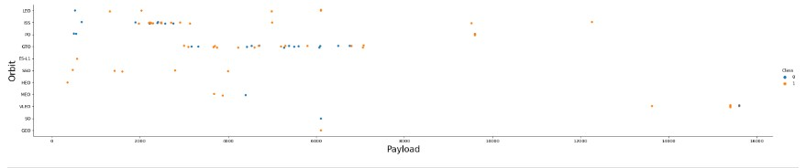
Payload vs. Orbit Type
Show a scatter point of payload vs. orbit type
- The below screenshot shows that heavy payloads have positive response LEO orbit and negative response on GTO orbits.

Slide 24
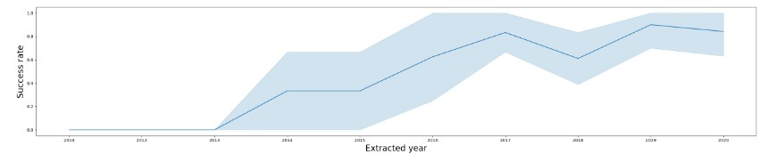
Launch Success Yearly Trend
Show a line chart of yearly average success rate
- The below screenshot shows success is steadily increasing from the year 2013.

Slide 25
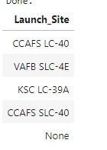
All Launch Site Names
- the names of the unique launch sites are shown in the screenshot.

Slide 26
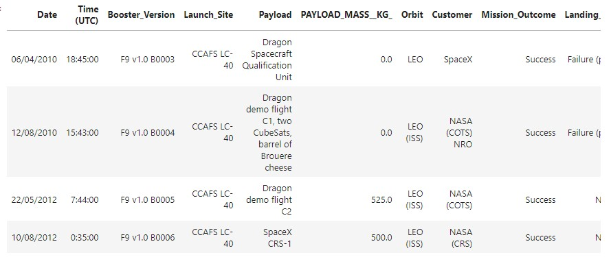
Launch Site Names Begin with 'CCA'
Find 5 records where launch sites begin with `CCA`

Slide 27
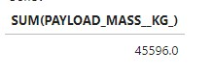
Total Payload Mass
-the below screenshot shows the total payload carried by boosters from NASA is 45596.0

Slide 28
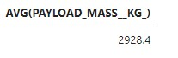
Average Payload Mass by F9 v1.1
The below screenshot shows the average payload mass carried by booster version F9 v1.1 is 2928.4

Slide 29
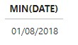
First Successful Ground Landing Date
The below screenshot shows the dates of the first successful landing outcome on ground pad is August 1,2018

Slide 30
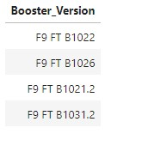
Successful Drone Ship Landing with Payload between 4000 and 6000
The below screenshot shows the names of boosters which have successfully landed on drone ship and had payload mass greater than 4000 but less than 6000

Slide 31
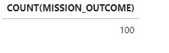
Total Number of Successful and Failure Mission Outcomes
The below screenshot shows the total number of successful and failure mission outcomes is 100

Slide 32
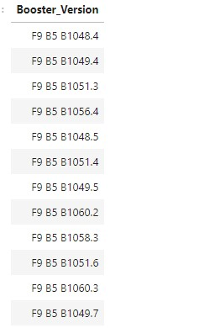
Boosters Carried Maximum Payload
The below screenshot shows the names of the booster which have carried the maximum payload mass

Slide 33
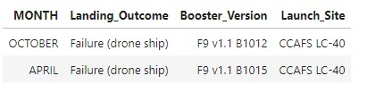
2015 Launch Records
The below screenshot shows the failed landing_outcomes in drone ship, their booster versions, and launch site names for in year 2015

Slide 34
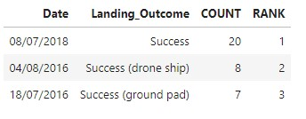
Rank Landing Outcomes Between 2010-06-04 and 2017-03-20
The below screenshot shows the Rank the count of landing outcomes (such as Failure (drone ship) or Success (ground pad)) between the date 2010-06-04 and 2017-03-20, in descending order

Slide 35

Section 3

Slide 36
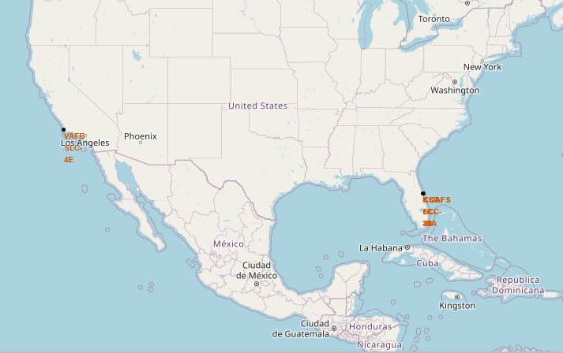
Launch sites
-The below screenshot shows the location of all launch sites in red label.

Slide 37
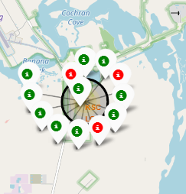
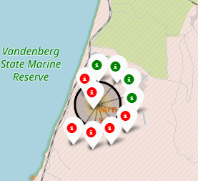
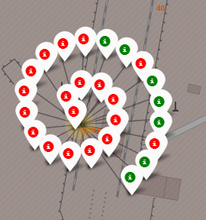
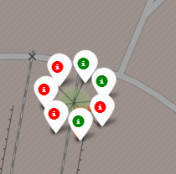
Launch Success
The below screenshot shows the launch sites success in green icon and failure in red icon.
From the screenshots we can conclude that KSC LC-39A has moss success among all of them
KSC LC-39A VAFB SLC-4E CCAFSLC-40 CCAFS SLC-40

Slide 38
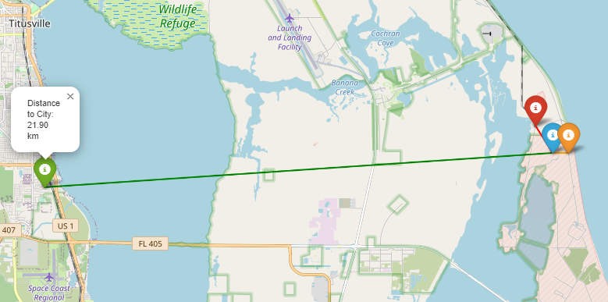
Distance from Launch site
The below screen shot shows launch site in blue icon, distance to city in green icon, distance to railroad in red icon and distance to highway road in orange icon.

Slide 39

Section 4

Slide 40
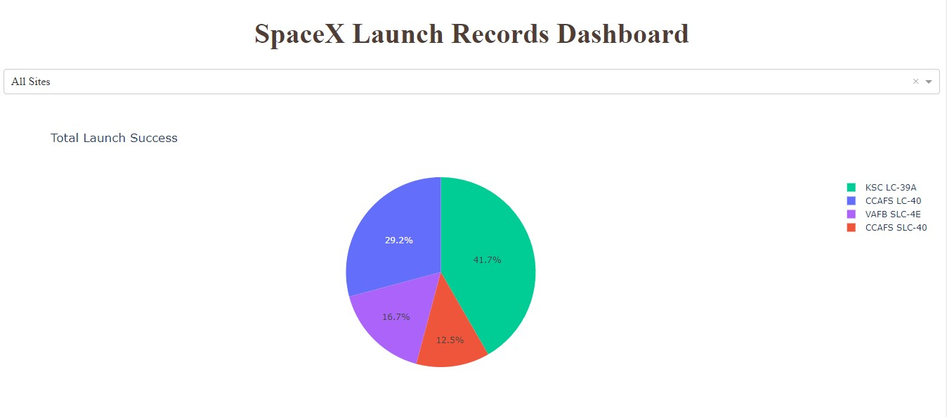
Launch success count
- The below screenshot shows the launch success count for all sites, in a piechart

Slide 41
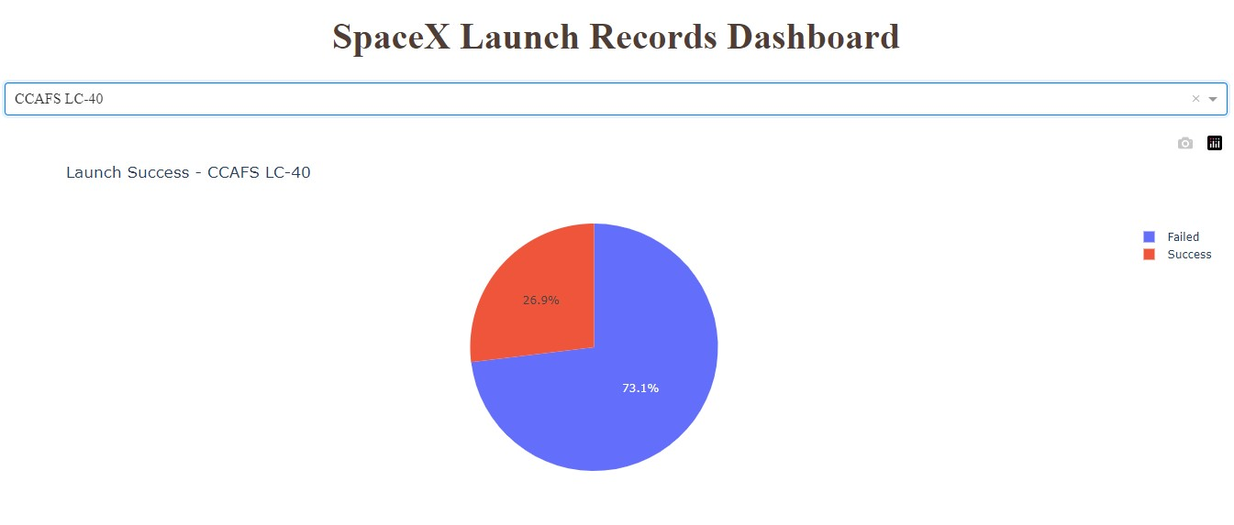
Lunch site with highest success ratio
-The below screenshot shows the piechart for the launch site with highest launch success ratio

Slide 42
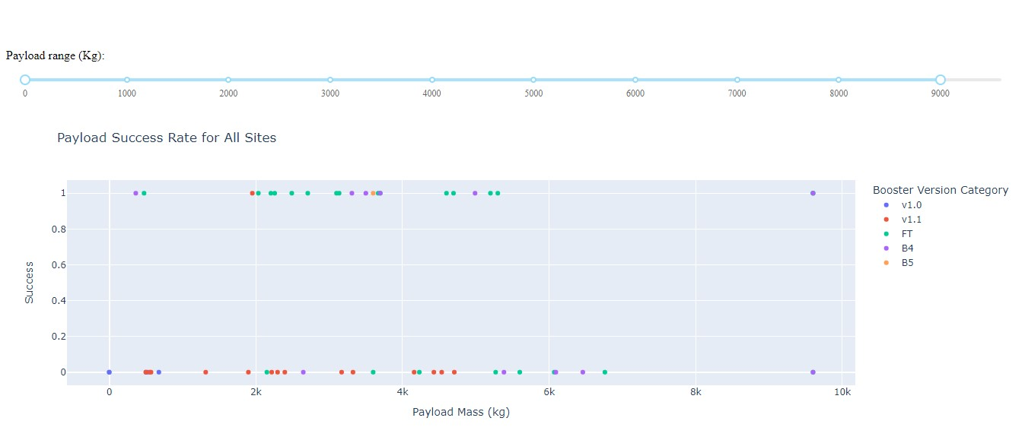
Payload vs Success
-The below screenshots shows the Payload vs. Launch Outcome scatter plot for all sites

Slide 43

Section 5

Slide 44
Classification Accuracy
From the bar chart we can conclude that Decision Tree has the highest classification accuracy.

Slide 45
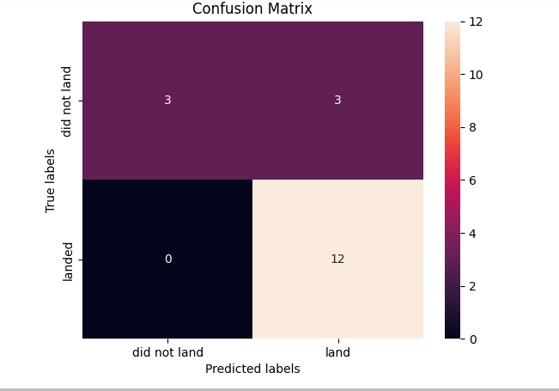
Confusion Matrix
-The below screenshot shows the confusion matrix of the best performing model “Decision Tree”

Slide 46
Conclusions
Data from SpaceX can be collected by both REST API and web scrapping.
Data visualization is performed by charts and plot like scatter plot, bar chart and line graphs.
SQL queries are performed.
Dashboard is created using pie chart, line chart and scatter plots.
Machine learning model is built and data are trained and tested.
We can conclude that Decision Tree Algorithm is the method based on accuracy.

Slide 47
Appendix
Include any relevant assets like Python code snippets, SQL queries, charts, Notebook outputs, or data sets that you may have created during this project

Slide 48


